Slide 1
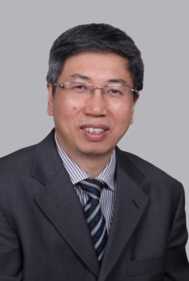
Guohua Zeng
Affiliation: The First Affiliated Hospital of Guangzhou Medical University
Vice-director, The First Affiliated Hospital of Guangzhou Medical University
Vice-president, Chinese Urological Doctor Association
Vice-Chair, Urolithiasis section of Chinese Urological Association
President, Urology section of Guangdong Doctors Association
Co-chairman and Secretary General of International Alliance of Urolithiasis (IAU)
Director, Certified fellowship program by Endourology Society
Board of Directors of Endourology Society
Inventor of Suction Mini PCNL(SMP) and FANS sheath
Have performed >20,000 Endourological procedures

